Slide 1
Review
Lesson 10

Slide 2
WHO ARE YOU?
Unit 1

Slide 3
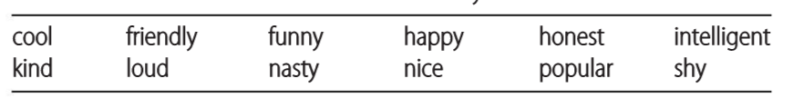
Similar or Different?
Circle two or three of these words to describe yourself.
Compare your answer with your partner.
Find out the similar or different words.
/ɪnˈtel.ə.dʒənt/
/ˈnæs.ti/

Slide 4
Who are you
Match the pairs of words that have a similar meaning. Use a dictionary if necessary. Then think of someone you know that you can describe with each pair of words.
Smart | Relaxed
Calm | b. Nice
Helpful | c. Intelligent
4. Cheerful | d. Kind
c
a
d
b

Slide 5
Who are you
Choose the correct option to complete each sentence.
1. I’m active / lazy at the weekend. I usually do some sport and go out with my friends.
2. He’s confident / nervous about giving presentations because he doesn't like making mistakes.
3. She's very sociable / shy and has a lot of friends.
4. Our coach is serious / easy-going and lets us listen to music before basketball practice.
5. Kenji is very hard-working / talented. He isn't the best, but he really wants to succeed.
6. Luis is really loud / quiet. You always know when he's in a room!
7. Maria's very honest / funny – she always makes her classmates laugh.
8. Samir usually helps his little sister with her homework. He's very nasty / kind.

Slide 6
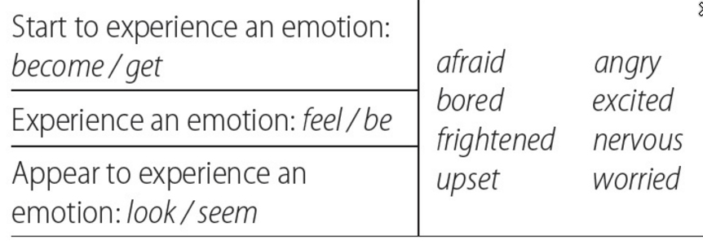
How are you feeling?
Look at the table and choose the best words to complete the sentences.
worried/ nervous
1. Are you ? Don't worry. The test won't be that bad.
2. I'm getting about my holiday next week.
3. They feel about their exams next month.
4. Dan upset about something, but I don't know what the problem is.
5. The teacher angry when everyone was late.
6. You nervous about the test, but I'm sure you'll do well.
excited
worried/ nervous
looks/ seems
became/ got; might become get
look/ seem

Slide 7
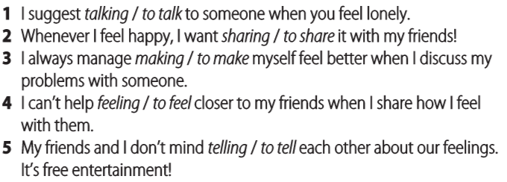
Verb patterns
Choose the correct option to complete each sentence.
Want [ + obj + -ing verb ]
can't/couldn't help
Help [ + obj + (to) infinitive ]
Mind [ + obj + -ing verb ]

Slide 8
Verb patterns
Complete the short conversations with the correct form of the verbs. Sometimes more than one option is possible.
1. A: I hate you, but can I ask for some advice?
B: I don't mind you, but I can't talk right now. I'm late for class!
2. A: Do you promise my secret? B: I'm not sure! Sometimes I can't help secrets!
3. A: I like about my feelings in a notebook. B: I don't do that. I prefer to someone face to face.
4. A: I plan you a postcard from my holiday. B: Oh, thanks. I love postcards.
5. A: My sister has agreed everything that happens at the concert.
B: Oh, good. Do you promise me everything too?
bother | help | send | talk | not tell
describe | receive | share | tell | write
to bother / bothering
helping
not to tell
sharing
to write / writing
to talk / talking
to send
receiving (UK)/ to receive (NA)
to describe
to tell

Slide 9
Where the heart is
Unit 2

Slide 10
Where you live
Complete the city descriptions with the words in the boxes.
A new city: Songdo, South Korea
Songdo International Business District is a ‘planned’ city in South Korea. It includes a (1) business area where companies like Samsung have offices, a (2) with shops and restaurants, and also (3) areas where people live. This includes a skate park and a lake with boats to hire. There's also a (4) and exciting entertainment area, with a concert hall, an arts centre and cinemas. Everywhere in the city is (5) , so people don't need to use their cars much. Bikes are very popular, too. None of the buildings in the city is (6) because the city is only a few years old.
lively | old-fashioned | residential | shopping district | walkable
shopping district
residential
lively
walkable
old-fashioned

Slide 11
Where you live
Complete the city descriptions with the words in the boxes.
An ancient city: Mexico City
Mexico City is about seven hundred years old. The city centre feels very busy and (7) urban, with busy shopping streets which sometimes get very (8) . However, Chapultepec Park, in the middle of the city, is the largest city park in Latin America. It has an amusement park, a swimming pool and an old castle. There aren't many (9) buildings in the (10) city centre. Construction began in the 1500s, so many buildings are old and (11) . There are, however, modern office buildings in Santa Fe, the city's business district. And there are homes and apartment buildings in the more quiet (12) areas, which grew around the city centre in recent times. There are also many beautiful (13) areas – areas without buildings – near Mexico City, like Desierto de los Leones National Park, which is actually within the city limits.
crowded | historic | modern | rural | suburban | traditional
crowded
modern
historic
traditional
suburban
rural

Slide 12
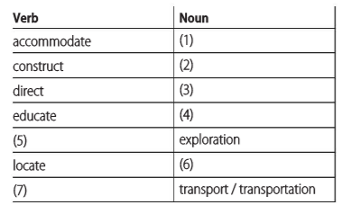
Suffix-ion
Read the Vocabulary building box. Then type the correct missing words. Use a dictionary if necessary. For nouns, please also check they are Countable or Uncountable.
[ U ] mainly UK; [ plural ] US
accommodation
[ U ] the work of building or making something;
[ C ] a building
construction
direction
[ C ] the position towards; [ U ] control or instruction
education
[ S or U ] It's important for children to get a good education.
explore
location
[ C ] a place or position;
[ U ] the act of finding the exact position of something
transport

Slide 13
Family and Friends
Unit 5

Slide 14
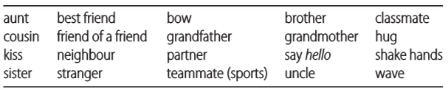
THE PEOPLE IN MY LIFE
Write the words in the correct column. Use a dictionary if necessary. Add one or two words of your own to each column.
FAMILY | OTHER PEOPLE | GREETINGS
aunt
grandmother
classmate
teammates(sports)
bow
shake hands
brother
sister
best friend
partner
hug
cousin
uncle
friend of a friend
kiss
wave
grandfather
stranger
neighbour
say hello

Slide 15

SUFFIX -AL
Read the sentences from the article. Match the words in bold with the correct meaning.
d
1. A girl's fifteenth birthday is a huge social occasion for many Latin American families.
2. The tradition has become international, spreading through Central and South America.
3. It marks a time of important personal change.
4. The event has both personal and historical importance.
a. Connected with many countries
a
b. Connected with the past
c
c. Connected with a person
b
d. Connected with groups of people

Slide 16
SUFFIX -AL
Complete the sentences with these adjectives.
Cultural | emotional | traditional | typical
1. The fiesta de quince años is hundreds of years old. It's a Mexican celebration. 2. Certain things are expected at most parties. At a party, the girl's father removes her shoes. 3. The party brings out strong feelings. The shoe-changing can be a very moment. 4. It's part of the Mexican way of life, but many countries don't have a tradition like this.
traditional
typical
emotional
cultural

Slide 17
SUFFIX -AL
What adjectives can you make from these nouns? Be careful. You need to remove a letter from some nouns.
centre
music
nature
politics
profession
central
musical
/ˈneɪ.tʃɚ/
natural
/ˈnætʃ.ɚ.əl/
political
professional

Slide 18
All in a day’s work
Unit 9

Slide 19
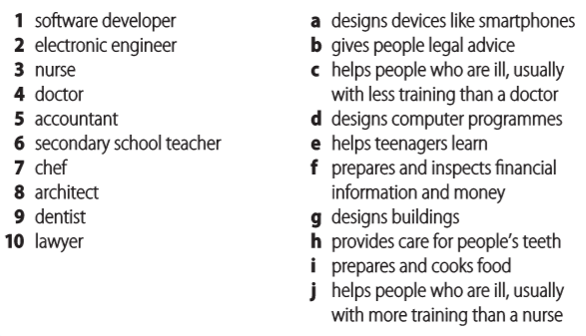
Match the jobs (1–10) with the correct description (a–j).
d
a
c
j
f
e
i
g
h
b

Slide 20
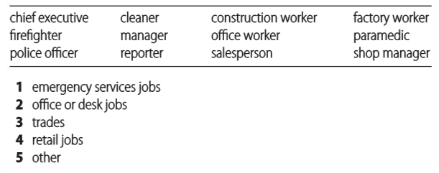
JOBS
Look at these jobs. Which category does each one belong to? Think of one more job for each category. Use a dictionary if necessary.
2
3
3
3,5
1
2,4
2
1
1
5
4
4
A job, especially one that needs special skill, that involves working with your hands:
She went to college to learn a trade.

Slide 21
Grammar-6 tenses

Slide 22
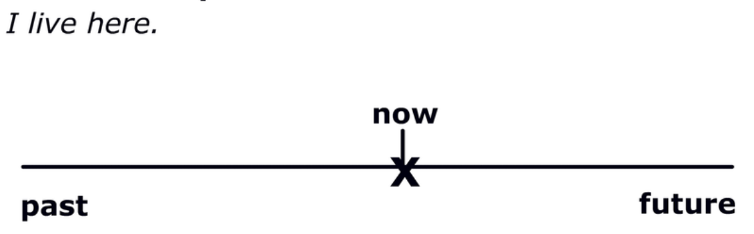
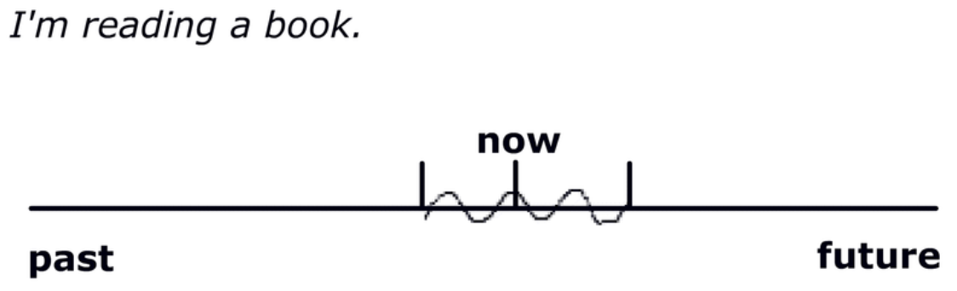
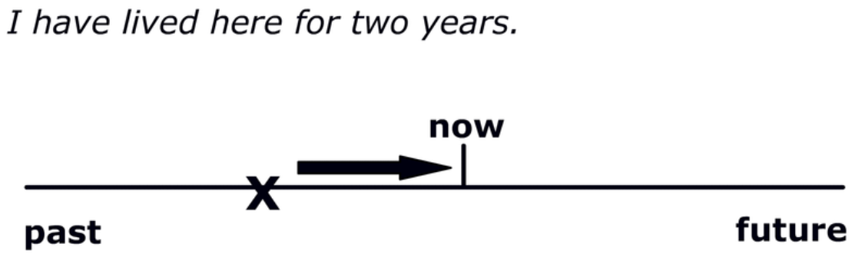
Talking about the present
1.
2.
3.
present simple
present continuous
present perfect

Slide 23
Complete the sentences with the correct form of the verbs or for/since/yet in brackets.
1. I _____ (not, can) watch them every time they practise because I ______________ (study) for an important exam.
2. I _________________ (not see) you __________ last summer.
3. I __________ (not, know) how to play any instrument at the moment, but I _____________ (learn) the keyboard. If I'm good, maybe I can join my brother's band!
4. _________ you _______________ (ever, read) about people in Lhasa sticking out their tongues? It’s a polite greeting there.
5. You ______________ (have) the same friends ________ ten years.
6. I __________________ (not, go) to Africa ________.
can't
am/'m studying
haven't seen
since
don't know
am/'m learning
Have
ever read
have had
for
have not been
yet

Slide 24
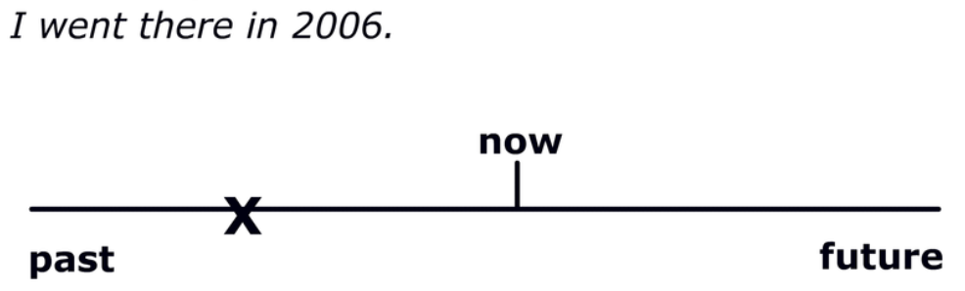
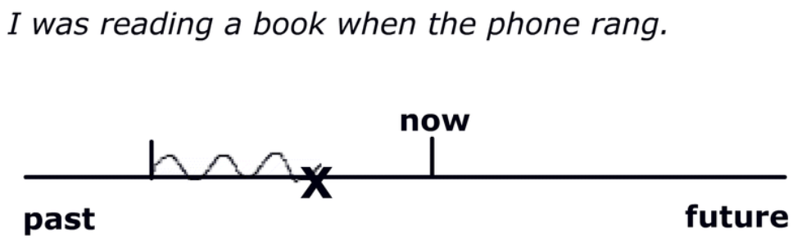
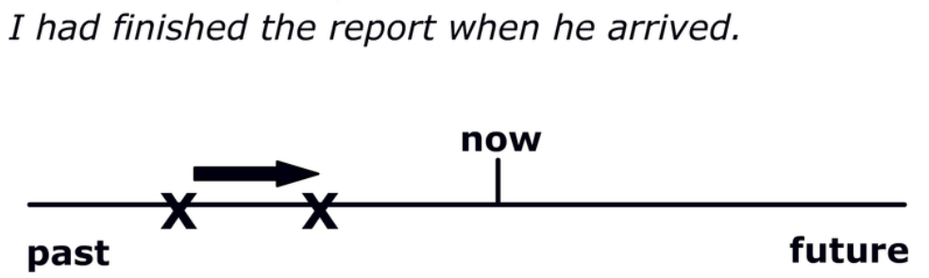
Talking about the past
1.
2.
3.
Past simple
B. Past continuous
C. Past perfect

Slide 25
Complete the sentences with the correct form of the verbs
heard
I _______________ (watch) TV when I _______________(hear) the news yesterday.
Elena _______________(write) a letter to her grandmother last week but ________ (forget) to send it.
The job market _______ already_______________ (become) worse when I returned from travelling.
I _______________ (meet) Antonio at the party last night.
I _______________(see) the job ad before Fay told me about it
The bus drove by while we _______________ (walk) to school.
My cousins and I _______________(go) to the beach every day last summer.
was watching
wrote
forgot
had
become
met
hadn't seen
were walking
went

Slide 26
Correct the mistakes in the sentences.
1. Before you text your friend yesterday, had you receive your teacher’s email?
2. Susan doesn’t be a doctor.
3. Does he works at a bank?
4. They weren’t go to the cinema yesterday.
5. They haven’t got dinner at 7 o’clock.
6. This computer was made by Japan.
7. I am preferring to buy clothes in boutiques.
8. How many cheese you add in this dish?
9. Do you ever tried weird food?
10.I was going to fly to NY next month.
11. The soup is smelling really good.
12. It get dark.
13. She has win the prize.
14. I am thinking he is a very intelligent boy.
15. I’ ve be waiting you at the station.

